Slide 1
UniSwap
Our website is a campus-based marketplace designed for Chitkara University students. It allows users to buy, sell, and exchange items easily within the campus.
The platform helps students find affordable products, sell unused items, and connect with trusted buyers and sellers nearby.
With a simple, user-friendly interface, our website makes transactions quick, safe, and convenient—creating a smart and sustainable student community.

Slide 2
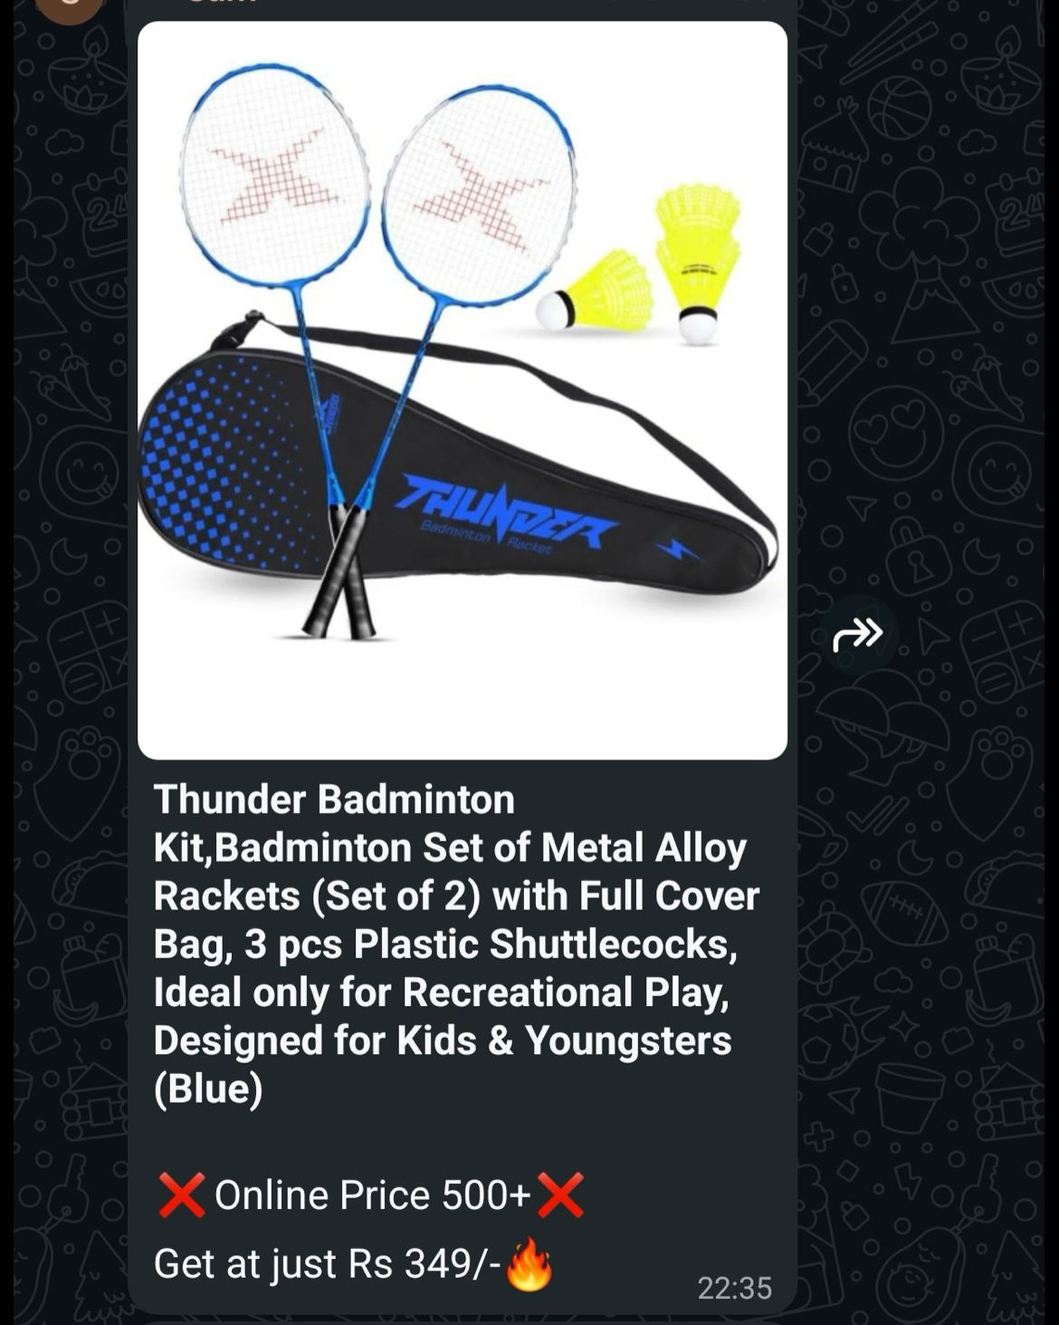
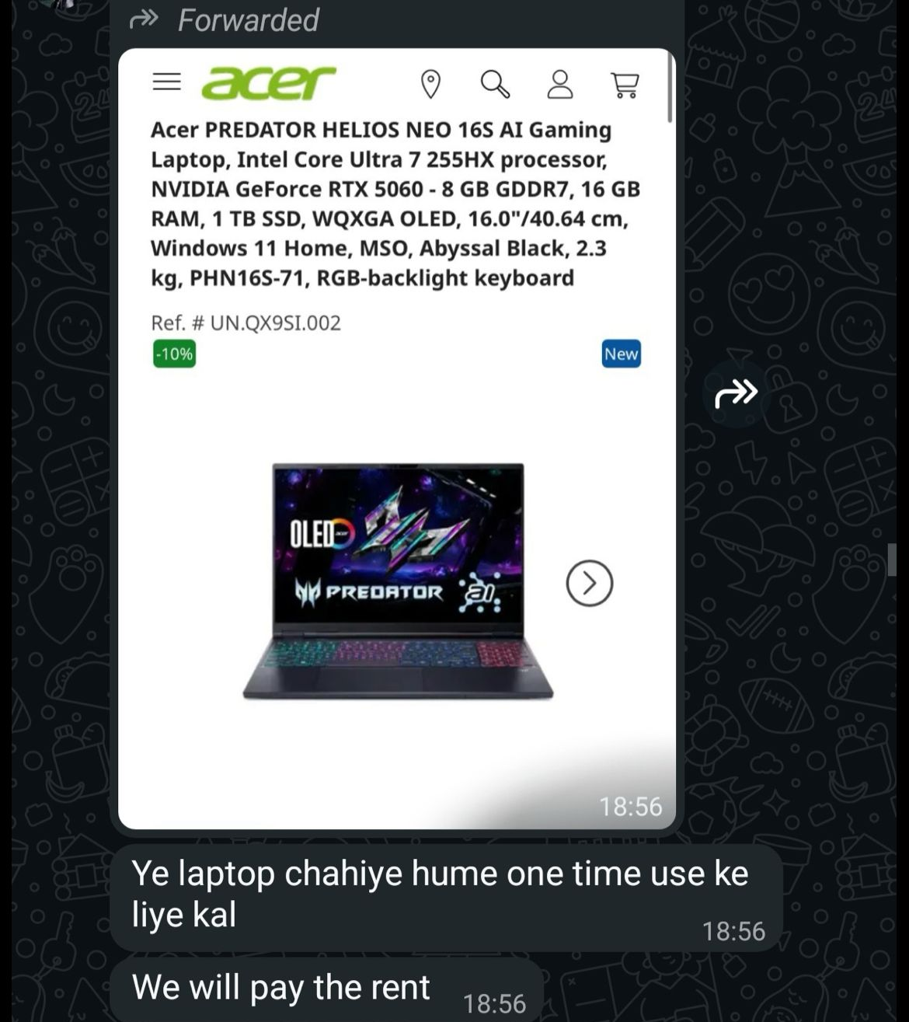
Problem We Identified
Students often rely on WhatsApp groups to buy or sell items within the campus, but this method is not efficient. Messages frequently get lost in long chats, and responses are often delayed or not received at all. It becomes difficult to find reliable sellers or buyers at the right time, leading to frustration and wasted effort. This unorganized communication system makes the entire process time-consuming and inconvenient for students.

Slide 3
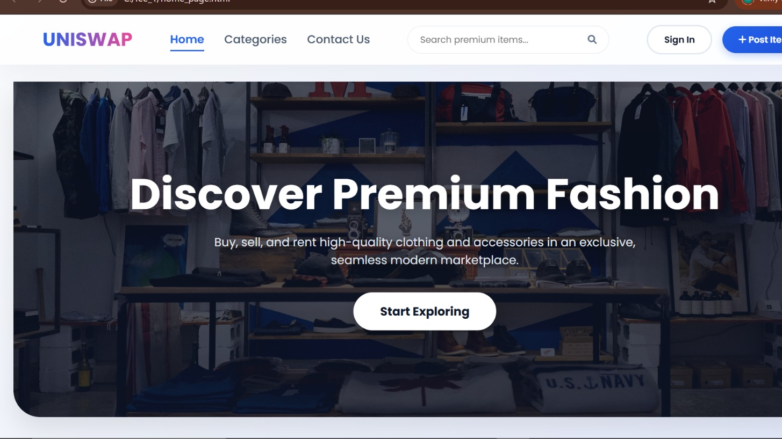
Introducing Our Platform
To solve these problems, we developed a dedicated campus marketplace platform where students can easily buy, sell, and exchange items in one place. Our website provides an organized and user-friendly interface where listings are clearly displayed, making it easy to find products quickly without scrolling through endless chats. It ensures better communication, faster responses, and a more reliable way to connect with buyers and sellers within the campus.

Slide 4
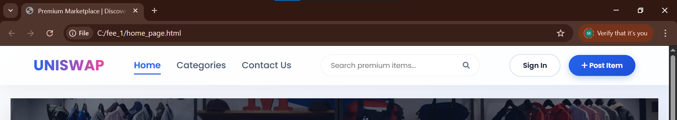
OverView
Contact page
Login Page
Home Page
Post to cell or rent
Categories Page
This slide provides an overview of our website’s homepage interface. It highlights the main navigation sections such as Home, Categories, and Contact, along with essential features like search functionality, login option, and the ability to post ads for selling or renting items. The design is simple and user-friendly, allowing students to easily navigate through the platform and access different services efficiently.

Slide 5
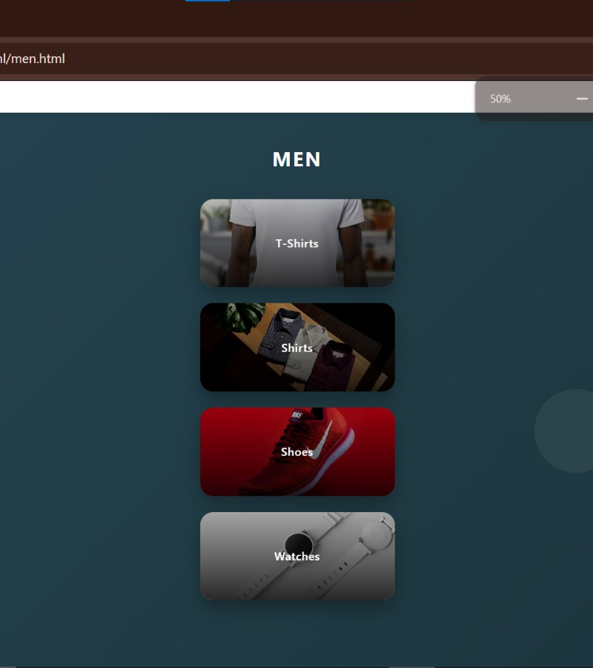
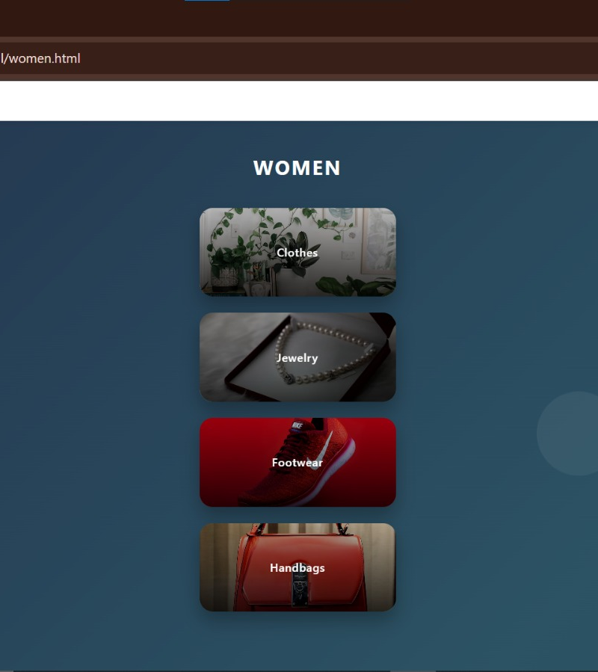
Features Of Website
Our website offers a range of useful features designed to make buying and selling simple and efficient for students. Users can easily browse different categories, search for specific products, and view detailed listings in an organized manner. The platform also allows users to post ads for items they want to sell or rent, making it convenient to connect with potential buyers. With a user-friendly interface, quick navigation, and reliable communication, the website ensures a smooth and hassle-free experience for everyone.

Slide 6
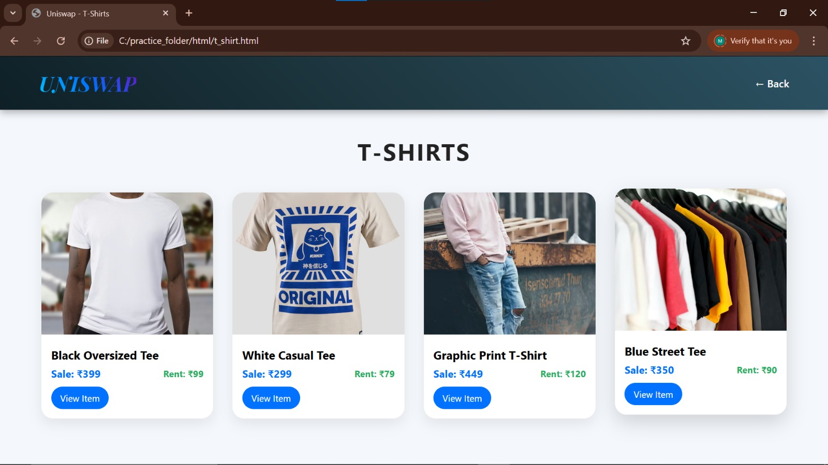
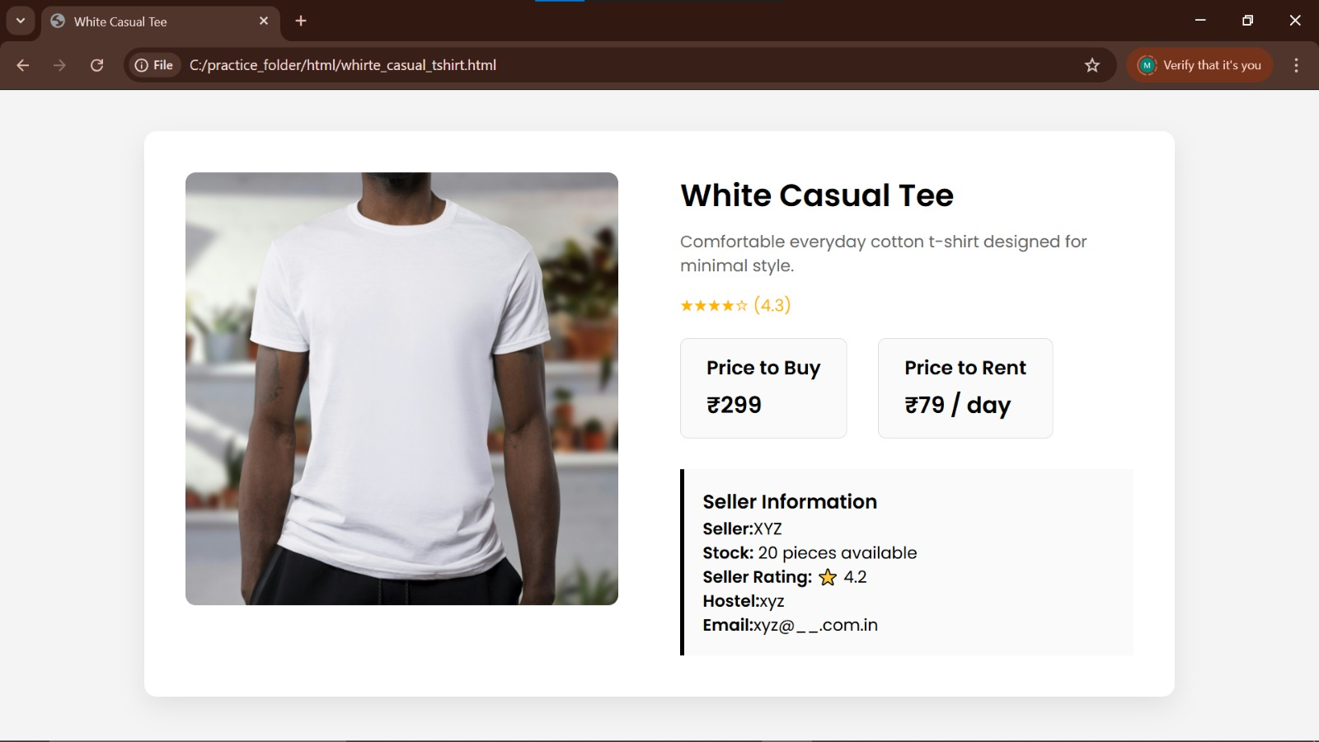
Basic Idea of Categories And Designs
Our website is designed with simple and well-organized categories to help users easily find the products they need. Items are divided into sections such as clothing, accessories, electronics, and daily essentials, making browsing quick and efficient. The overall design is clean, modern, and user-friendly, ensuring smooth navigation for all users. With a clear layout and attractive interface, the platform enhances the user experience and makes buying and selling more convenient within the campus.

Slide 7
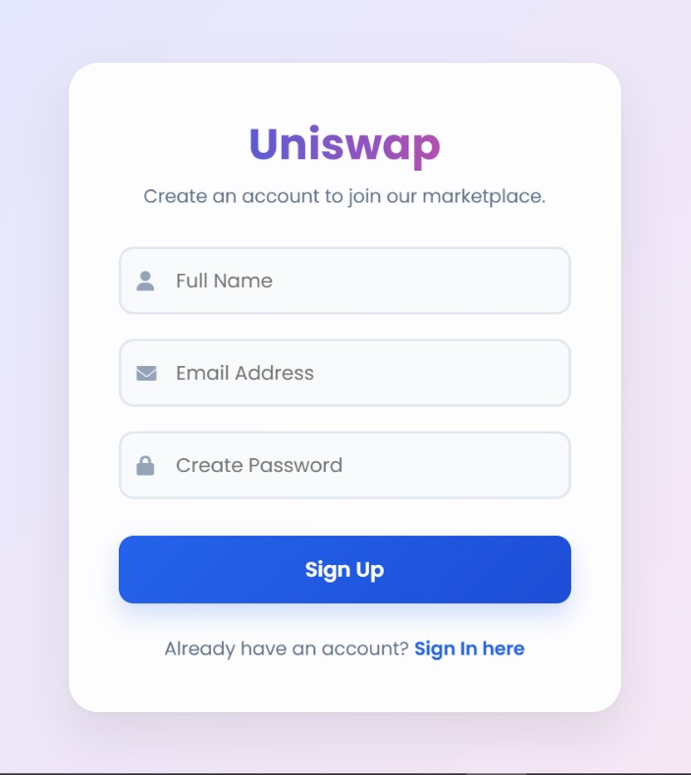
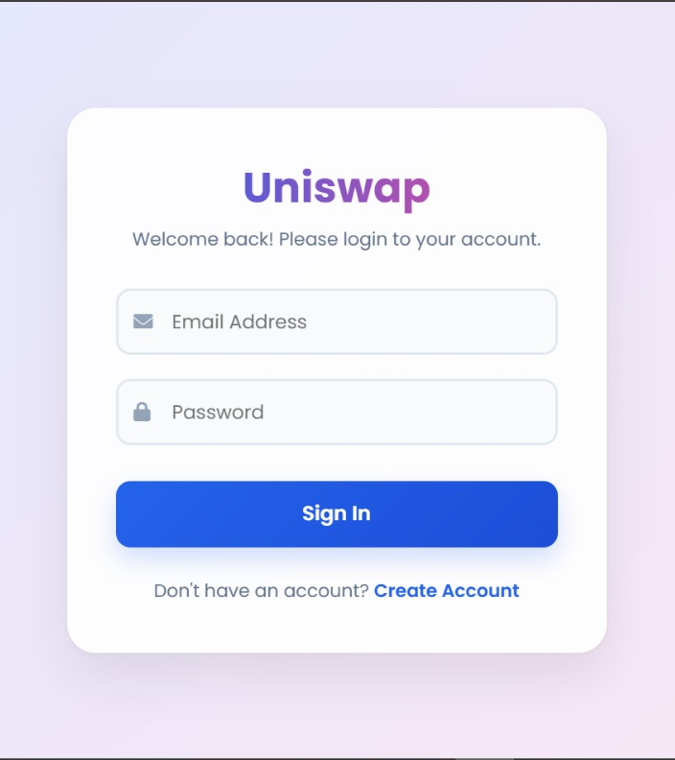
How It works?
Step 1: User logs in
Step 2: Uploads product
Step 3: Buyer connects
Step 4: Deal done
for this

Slide 8
Advantages And Benefits
Our platform offers several advantages to students by making buying and selling easy and efficient within the campus. It saves time by providing all products in one place, eliminating the need to search through multiple WhatsApp groups. The organized system ensures better communication and quicker responses between buyers and sellers. It is user-friendly, reliable, and helps students find affordable items while also giving them an opportunity to sell unused products. Overall, it creates a convenient and trusted marketplace for the student community.
Future Scope
Add Payment system Chat Feature Mobile App Version

Slide 9
Conclusion
In conclusion, our website provides a simple and effective solution to the problems students face while buying and selling products within the campus. By replacing unorganized communication methods with a structured platform, it makes the process faster, easier, and more reliable. This project not only improves convenience but also creates a connected and efficient student marketplace, making everyday transactions smoother and more accessible for everyone.

Slide 10
Thank you
Submitted By:
Submitted to:
Kashyap Gupta(2510993320)
Mohana(2510993329)
Yashik Mittal(2510993350)
Sadhana(2510993368)
Mr. Sourabh

